Slide 1
INSTRUCTIONS
This slide pack introduces the IOGP Life-Saving Rules
If you are implementing the Rules, please consult IOGP report 459 for further guidance
IOGP asks all users to not modify the Rules (icons or wording) in any way.
Organisations can adapt the contents of these slides, for example to describe:
  For each Rule, site/company process and procedures that the Rule is relevant to
  What is expected of each person
  What should someone do if they cannot follow a Life-Saving Rule on a specific day/task?
We have included case studies to help start discussions of how the Life-Saving Rules work in practice.
  IOGP recommends you use examples from your own site or company history.
  Case Studies can be about a fatal event, or a near-miss
  IOGP is developing nine ‘Rule in a Minute’ video animations that can compliment this introduction. These will be available by the end of September 2018, please visit https://www.iogp.org/life-savingrules/ to download

Slide 2
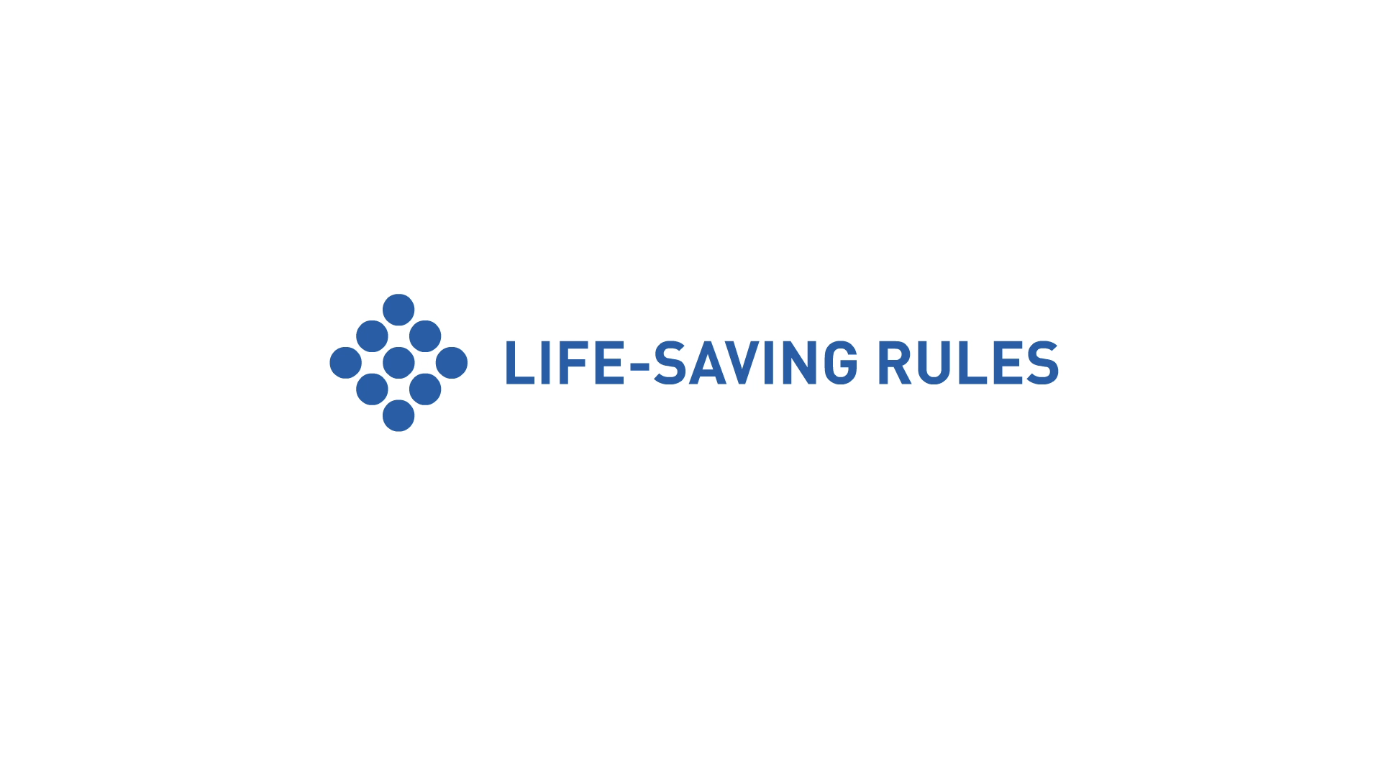
Version: 30th July 2018
Notes:
CLICK TO SHOW ANIMATION

Slide 3
What are Life-Saving Rules?
  Key actions to prevent fatal injuries during higher-risk activities
  Life-saving
  Few
  Clear
  Simple
  Task-level
  Proactive
  Actionable
  Observable
  For the Worker

Slide 4
How were the Life-Saving Rules developed?
We wanted to provide workers in the industry with actions they can take to protect themselves and their colleagues, no matter the worksite
Reviewed fatal incidents reported to IOGP to select the activities that are most likely to lead to a fatality
We wanted to have only Rules that were relevant and applicable for the
entire industry
Checked our selection against other industry data sources (CONCAWE, ARPEL, NIOSH, OSHA)
We created 9 Rules with a simple icon, and clear actions for individuals
Tested with workforce representatives and Human Performance experts

Slide 5
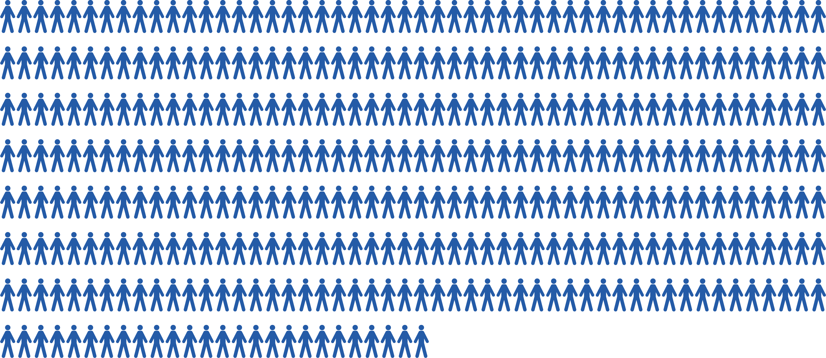
In the last 10 years, 376 people might still be alive if the Life-Saving Rules had been followed*

Slide 6
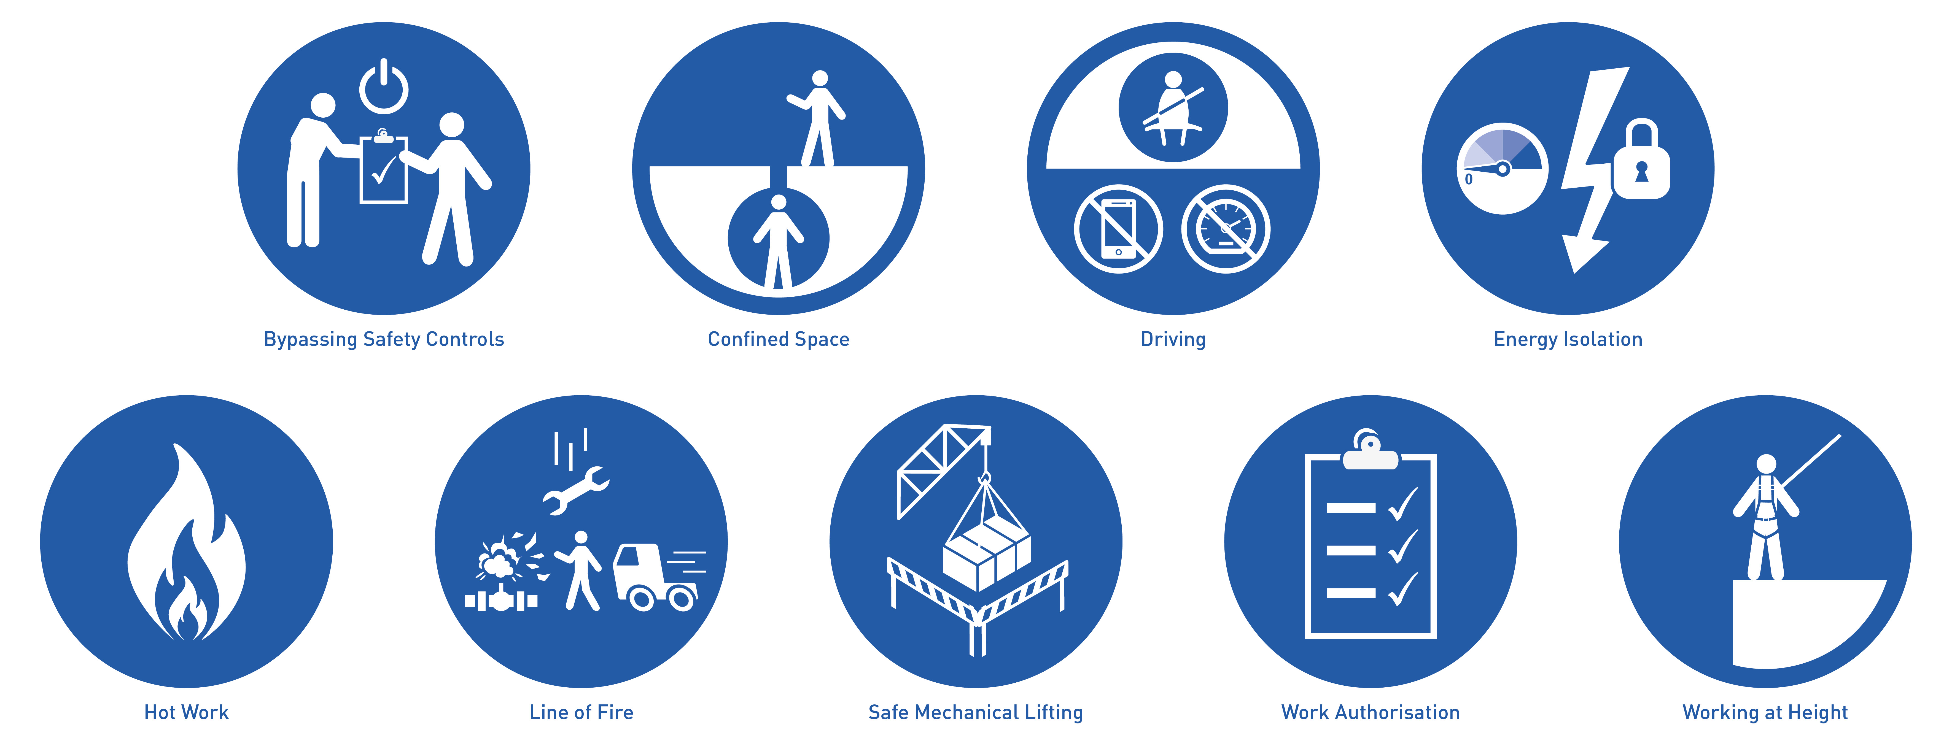

Slide 7
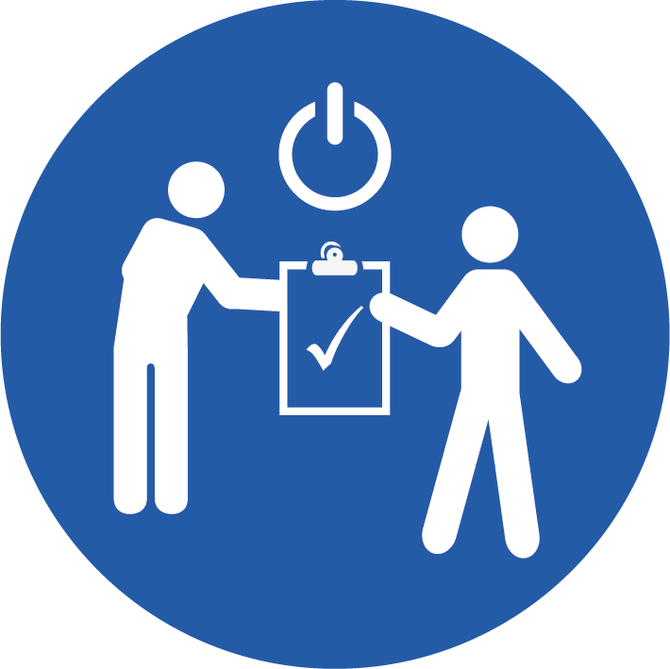

Bypassing Safety Controls
Obtain authorisation before overriding or disabling safety-controls
I understand and use safety-critical equipment and procedures which apply to my task
I obtain authorisation before:
  disabling or overriding safety equipment
  deviating from procedures
  crossing a barrier

Slide 8
Bypassing Safety Controls: Obtain authorisation before overriding or disabling safety-controls
Case Study
A senior Operator who had just started his morning shift went to check the pig receiver station for the presence of a pig launched into the 13” gas pipeline (13 km, 1050 psi). As the pig transit time was highly variable (from few hours to days), it was local practice to repeatedly open the pig trap, the pig signaller was considered unreliable. Some 20 minutes later the pig trap closure shot forward. The ensuing blast resulted in the victim and a VSD skid (3300lbs) being propelled overboard. The victim did not survive.
Safety-critical controls include:
Equipment (such as fire and explosion protection and mitigation systems, guards, interlocks, alarms and safety-critical monitoring equipment) whose purpose is to prevent a fatality or other major accident, limit the consequences of a major accident, or whose failure could cause or contribute substantially to a fatality or other major accident.
Procedures that if not performed correctly or at the right time could result in a fatality or other major accident.
Notes:
INVOLVE YOUR AUDIENCE – DISCUSS WHAT THIS MEANS FOR THEM
Some possible points below.
For example:
isolation devices
emergency shut down valves
lock out/tag out devices
equipment interlocks
relief valves
fire and gas alarm systems
certain level controls
Alarms
crane computers
In-Vehicle Monitoring Systems
life jackets
Respirators
Work-at-height harnesses.

Slide 9
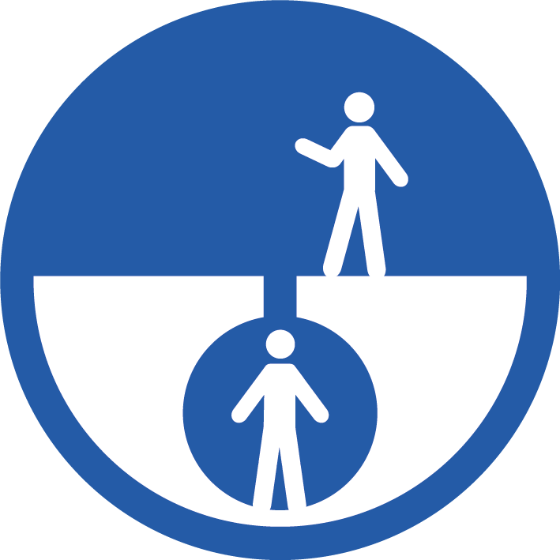
Confined Space
Obtain authorisation before entering a confined space
I confirm energy sources are isolated
I confirm the atmosphere has been tested and is monitored
I check and use my breathing apparatus when required
I confirm there is an attendant standing by
I confirm a rescue plan is in place
I obtain authorisation to enter

Slide 10
Confined Space: Obtain authorisation before entering a confined space
Case Study
Two Welders were working together to repair an external weld on a vertically orientated pipe spool. Following the completion of the repair, one of the welders placed a ladder inside the pipe spool and entered the pipe to inspect the weld repair. Upon entering the pipe they collapsed. The other welder went to try to rescue his colleague, entered the pipe and also collapsed. Both welders died.
A confined space, such as a vessel, tank, pipe, cellar, or excavation can contain:
explosive gas,
toxic or asphyxiating atmosphere
or other dangers such: as energy releases, lack of oxygen, exposure to hazardous chemicals, things that can fall on you or crush you, or that you can fall from.
Authorised access keeps you safe.
Notes:
INVOLVE YOUR AUDIENCE – DISCUSS WHAT THIS MEANS FOR THEM
Some possible points below.
Confined spaces are enclosed or partially enclosed spaces that are not designed or constructed for continuous human occupancy, have limited or restricted means for entry or exit, and where there is risk of injury or illness from hazardous substances or conditions.
Confined spaces include, but are not limited to, underground vaults, tanks, storage bins, manholes, pits, silos, process vessels, pipes and tubulars. Constant vigilance is required during construction to recognize and manage new confined spaces which may be created, including entering tubulars/piping for testing or inspection.

Slide 11
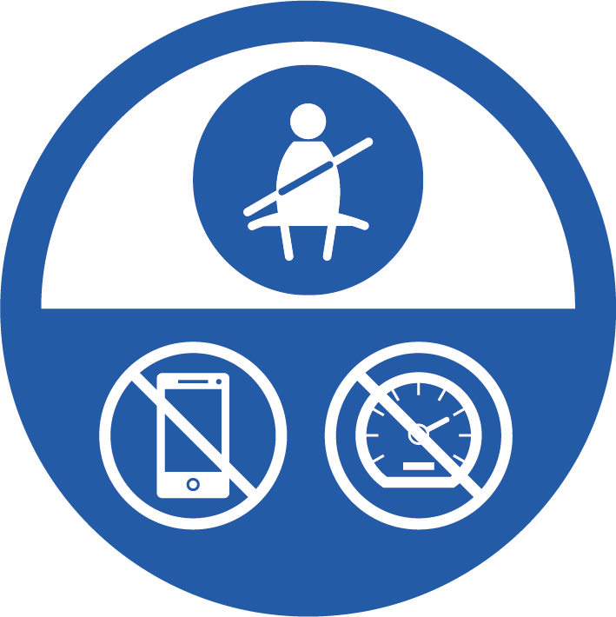
Driving
Follow safe driving rules
I always wear a seatbelt
I do not exceed the speed limit, and reduce my speed for road conditions
I do not use phones or operate devices while driving
I am fit, rested and fully alert while driving
I follow journey management requirements
Notes:
Talk about the practical implications:
How to know if you are well rested?
What does Journey Management mean for various types of trips?

Slide 12
Driving: Follow safe driving rules
Case Study
A third party vehicle was overtaking in an unsafe place.
It hit a Company vehicle head on.
Both vehicles were severely damaged in the crash. The company driver and passengers were wearing seatbelts and walked away from the crash. The driver of the other vehicle was not wearing a seatbelt and did not survive.
Both driver and passengers should take responsibility for each other’s safety, for example by ensuring all occupants are wearing a seatbelt and the driver is not distracted or fatigued.
Fitness for duty means assuring that an individual can complete a task safely and without unacceptable risk to themselves or other. This includes not being under the influence of drugs and alcohol.
Notes:
INVOLVE YOUR AUDIENCE – DISCUSS WHAT THIS MEANS FOR THEM
Some possible points below.
Does your company have any guidance on spotting the signs of fatigue you could point your audience to?
What are your company journey management requirements? Where would someone check if any applied to a work-related trip they need to take?

Slide 13

Energy Isolation
Verify isolation and zero energy before work begins
I have identified all energy sources
I confirm that hazardous energy sources have been isolated, locked, and tagged
I have checked there is zero energy and tested for residual or stored energy

Slide 14
Energy Isolation: Verify isolation and zero energy before work begins
Case Study
A contractor employee was electrocuted when a new power pole was raised prematurely and contacted an energised overhead electrical line, conducting current through the pole’s ground wire to a worker on the ground. The new power pole was being installed between two existing poles that held the energised overhead lines.
Energy isolation separates people from hazards such as electricity, pressure and energised equipment.
Energy isolation also provides protection from potential energy sources e.g. positioning valves to prevent tanks filling with materials due to gravity.
Any stored energy (hydraulic or pneumatic power, for instance) should also be released before the work starts.
Notes:
Examples of energy sources: electrical, pneumatic, mechanical, thermal, hydraulic, chemical, gravity, rotational.
Recognise these may be not be visible or immediately obvious
Overhead powerlines and underground utility lines need to be isolated before work nearby can start

Slide 15

Hot Work
Control flammables and ignition sources
I identify and control ignition sources
Before starting any hot work:
  I confirm flammable material has been removed or isolated
  I obtain authorisation
Before starting hot work in a hazardous area I confirm:
  a gas test has been completed
  gas will be monitored continually

Slide 16
Hot Work: Control flammables and ignition sources
Case Study
Three contractors died and one contractor suffered serious injuries in an explosion and fire at an oil field. The contractors, were standing on top of a series of four oil production tanks. They were preparing to weld piping to the tanks when a welding tool likely ignited flammable vapours from the tanks.
Click here to see a video produced by the CSB
Ignition sources are open flames or sources of heat that could ignite materials in the work area such as welding, grinding, smoking, torching, (un)loading of hazardous materials, internal combustion engines, chemical reactions, batteries, etc
Hot work includes any work that creates an ignition source performed in an area which has potential for hydrocarbons or flammable materials.
Notes:
INVOLVE YOUR AUDIENCE – DISCUSS WHAT THIS MEANS FOR THEM
Some possible points below.
Examples of energy sources: electrical, pneumatic, mechanical, thermal, hydraulic, chemical, gravity, rotational.
Recognise these may be not be visible or immediately obvious
Overhead powerlines and underground utility lines need to be isolated before work nearby can start

Slide 17
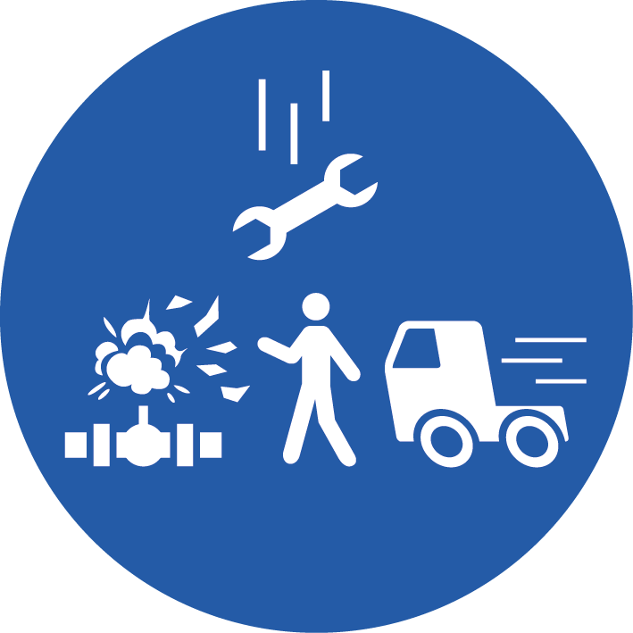
Line of Fire
Keep yourself and others out of the
line of fire
I position myself to avoid:
  moving objects
  vehicles
  pressure releases
  dropped objects
I establish and obey barriers and exclusion zones
I take action to secure loose objects and report potential dropped objects
Notes:
PLEASE MENTION THIS:
Other Rules focus on specific activities, but this Rule is to create personal awareness of struck-by and caught-in-between hazards.
IOGP decided to do this because from the data reported to us, when something goes wrong, the difference between a near miss and a serious injury or fatality is often if a person was ‘in the line of fire’.
About a third of the personal safety fatalities analyzed (ie excluding aviation incidents, process safety events and security incidents) analyzed were as a result of people being in the line of fire.

Slide 18
Line of Fire: Keep yourself and others out of the line of fire
Case Study
A truck used for transporting workers, water and equipment was parked at a worksite with the engine still running. During a break, workers approached the truck to get water. All workers but one return to their work. This worker had collected sand bags from the truck and was preparing the bags for use while sitting next to the truck. The driver did not notice him, and without performing any walk-around, started the truck, fatally running over the worker.
Line of fire hazards are not always obvious or constant, and can be introduced as the task progresses.
At all times individuals continually monitor their surroundings and position themselves to avoid being in the line of fire. This includes ensuring you are visible to vehicle drivers and equipment operators.
Individuals recognise when they create a line of fire hazard and put others or themselves in the line of fire.
Notes:
INVOLVE YOUR AUDIENCE – DISCUSS WHAT THIS MEANS FOR THEM
Some possible points below.
Examples: underground and overhead powerlines, pipelines, objects under pressure, stored energy, lines under tension, poorly supported excavations, shifting cargo.
IOGP recommends you give examples from your own company/site history
Things dropping
Being hit by moving equipment
Being caught-in, crushed by and trapped under equipment
Being hit by pressurized equipment

Slide 19
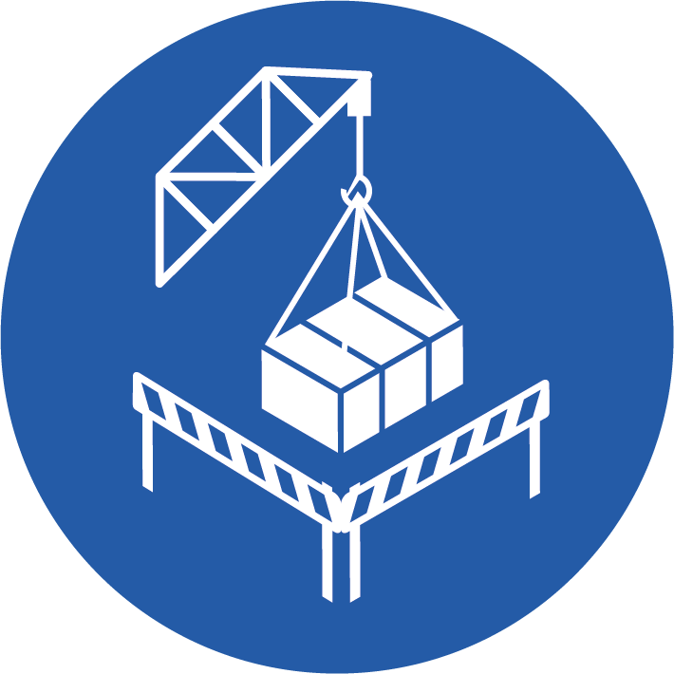
Safe Mechanical Lifting
Plan lifting operations and control
the area
I confirm that the equipment and load have been inspected and are fit for purpose
I only operate equipment that I am qualified to use
I establish and obey barriers and exclusion zones
I never walk under a suspended load

Slide 20
Safe Mechanical Lifting: Plan lifting operations and control the area
Case Study
A crew was pulling out the pump and tubing from a water well to move it to another well. The pipe joints were pulled out directly by connecting the auxiliary hook of a crane with the lifting sub on the pipe joint. As the bottom side of a pipe joint was placed on the ground, and while the top portion was still being lowered, the lifting sub with tubing got disconnected from the crane hook. The pipe fell towards the well where a worker was standing and connecting another lifting sub, fatally injuring him.
A suspended load is an object that is temporarily lifted and hangs above the ground, it can fall on you, or swing and crush you.
Lifting operations need to be planned and performed by competent personnel using certified equipment that has been inspected and is fit for the specific lift.
To protect people around suspended loads and any lifting operations, access should be controlled through physical barriers and exclusion zones.
Notes:
INVOLVE YOUR AUDIENCE – DISCUSS WHAT THIS MEANS FOR THEM
Some possible points below.
This Rule was derived from lifting related fatalities which were primarily in mechanical lifting operations such as fixed and mobile cranes, forklifts and other mechanical lifting devices. The principles apply for all lifting operations
Lifting equipment (appliances and accessories) and tools must be suitable for the job and used in accordance with the manufacturers guidance.
Loads should be inspected for integrity and the presence of unsecured objects.

Slide 21

Work Authorisation
Work with a valid permit when required
I have confirmed if a permit is required
I am authorised to perform the work
I understand the permit
I have confirmed that hazards are controlled and it is safe to start
I stop and reassess if conditions change

Slide 22
Work Authorisation: Work with a valid permit when required
Case Study
A terminal process system was pressuring up at the final stage of whole plant shut down for maintenance, a gas leakage was found around the door of a Refrigeration Unit filter. Two Mechanics were informed to fix it. After the filter was depressurised by one of the duty operators, they started working on the filter without authorisation from the site management. While the Junior Mechanic was loosening the bolts under the instruction of the Senior Mechanic, the door burst open fatally injuring the Senior Mechanic.
Work authorisation is more than just a person in charge signing a Permit to Work form: it is seeking and having authorisation to start, resume, or hand-over a task.
The person in charge of the work confirms that it is safe to start, that controls are in place and effective and the task can be performed as planned.
If anything changes during the work, stop and reassess.
Notes:
INVOLVE YOUR AUDIENCE – DISCUSS WHAT THIS MEANS FOR THEM
Some possible points below.
Talk about the specific activities in your Company or site that require a 'permit to work', for example excavation, confined space entry, hot work.
A Permit to Work system led by one single authority controls what you are doing in relation to other activities that may affect each other (aka Simultaneous operations)
Examples of changing conditions:
Handover
change of personnel
Weather
different or missing equipment
changes in surrounding operations

Slide 23
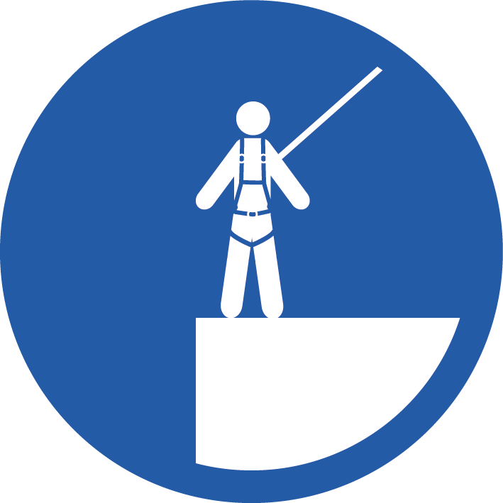
Working at Height
Protect yourself against a fall when working at height
I inspect my fall protection equipment before use
I secure tools and work materials to prevent dropped objects
I tie off 100% to approved anchor points while outside a protected area
Notes:
IOGP recommends that companies define working at height as work at or above 1.8m/6ft , unless local legislation requires a lower height.

Slide 24
Working at Height: Protect yourself against a fall when working at height
Case Study
A derrick person was working on the derrick board of a rig. After taking a break, the individual climbed back up to the derrick board and did not attach his fall protection device after unhooking from the climb assist. The worker grabbed the first stand of pipe with the tail rope which helped keep his balance as the elevators were being sent up to attach to the pipe. When he released the tail rope, he lost his
balance and fell 90 ft. to the rig floor, where he was fatally injured.
Working at height outside a protected area (such as an elevated work area not enclosed by hand rails) requires the use of approved fall protection equipment secured to an approved anchor point. Other considerations for working at height include ladders, work over water, rope access, floor openings, access hatches, and inspection pits. Floor openings should be protected with physical barriers to prevent falls.
Preventing objects from falling from height and using physical barriers below working area keeps you and people working below you safe.
Notes:
INVOLVE YOUR AUDIENCE – DISCUSS WHAT THIS MEANS FOR THEM
Some possible points below.
Other considerations for working at height include ladders, work over water, rope access, floor openings, access hatches, and inspection
A protected area is fixed, stable and with edge protection designed to prevent a fall, examples include approved scaffolds, fixed platforms, guarded mezzanine floors, elevated work platforms with fixed guardrails.
Scaffolds should be properly constructed, inspected and certified.

Slide 25





How should I use Life-Saving Rules?
STOP
Toolbox talks & Safety meetings
Can we learn from incidents that involved a Life-Saving Rule not being followed?
Pre-job planning
Are we doing any work today involving a Life-Saving Rule?
How can we follow the Rule from start to finish?
What needs to be in place?
Is everything in place, and in good working condition?
Last minute risk assessment
Have I done all the Life-Saving Rules actions?
Is everything as we discussed in the pre-job planning?
Are there any Line of Fire hazards or ignition sources we didn’t identify?
Post-job reviews
Did we take all the actions associated with the Life-Saving Rules?
What went well? What didn’t go well?
Anything to note for the next time we have to this perform task or work in this area?
Observations & walkabouts
Do you see anyone performing work where a Life-Saving Rule is relevant?
Are they following the Rule?
Yes? Great, recognise it!
No? Intervene!
Intervention
Intervene or stop the work if a Life-Saving Rule is not being followed

Slide 26
Work does not start until we are all aware of the Life-Saving Rules and can confirm we can follow them throughout
We are all authorised to intervene or stop work if we are in any doubt about the safety of an activity or we can't follow the Rules
STOP
Notes:
Everyone has the authority and is encouraged to stop work and intervene if they observe potential or actual non-compliance to the Life Saving Rules, or any other unsafe activity. Proactive intervention may be the last opportunity to prevent injury or fatality.

Slide 27
We are all authorised to intervene or stop work
STOP
Intervention can be the last opportunity to prevent injury or a fatality
I know, but it is not always easy to tell someone to stop the job
Exactly, specially if it’s your boss!
Yeah, but I guess it is better to have an uncomfortable conversation now, than someone getting hurt
Notes:
Everyone has the authority and is encouraged to stop work and intervene if they observe potential or actual non-compliance to the Life Saving Rules, or any other unsafe activity. Proactive intervention may be the last opportunity to prevent injury or fatality.

Slide 28
When the Life-Saving Rules are followed, we all get to return home to our friends & family safely

Slide 29

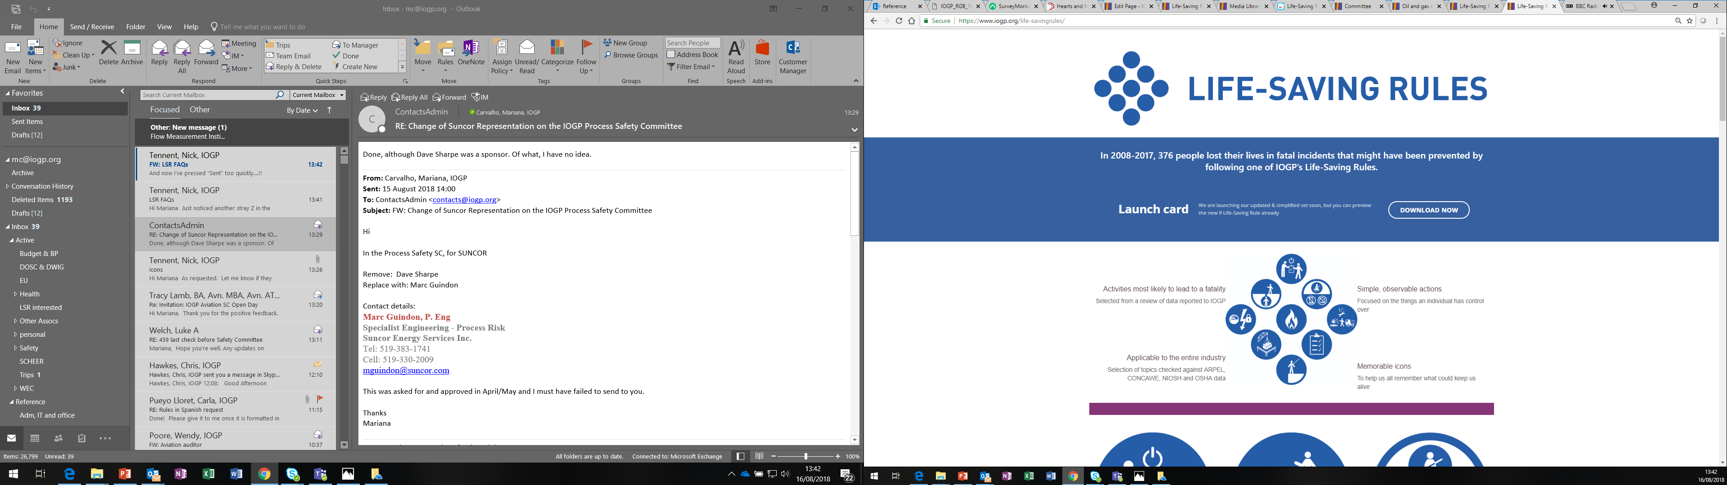







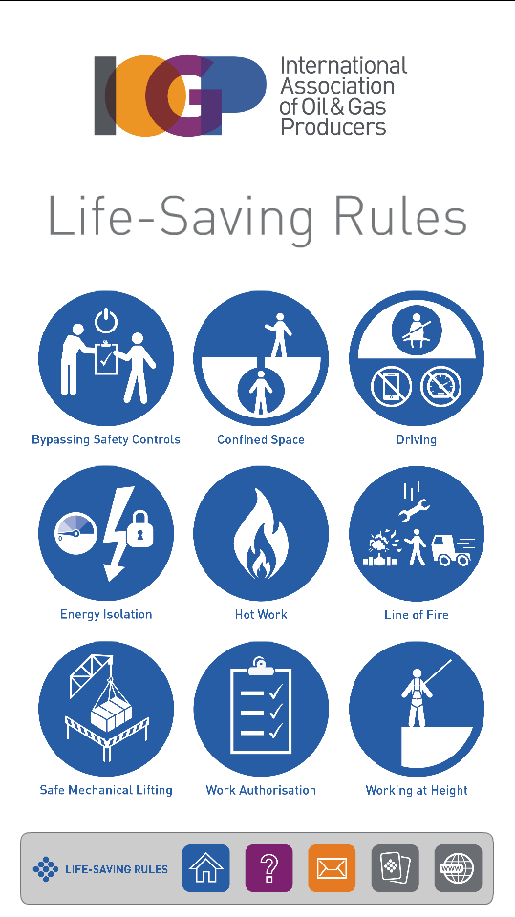


Also available
Website
App
Quiz
Videos
Posters
Presentations
Workcards
Get in touch!
infoLSR@iogp.org
+44 (0)20 3763 9700

