Slide 1
INSTRUCTIONS
This slide pack could be used to introduce leaders at all levels in an organisation to the IOGP Life-Saving Rules
If you are implementing the Rules, please consult IOGP report 459 for further guidance
IOGP asks all users to not modify the Rules (icons or wording) in any way.
Organisations can to adapt the contents of these slides, for example to describe:
What is expected of leaders?
What should someone do if they cannot follow a Life-Saving Rule on a specific day/task?
Is the implementing organisation applying any consequence management?

Slide 2
Notes:
CLICK TO SHOW ANIMATION

Slide 3
What are Life-Saving Rules?
Key actions to prevent fatal injuries during higher-risk activities
Life-saving
Few
Clear
Simple
Task-level
Proactive
Actionable
Observable
For the Worker

Slide 4
The IOGP Life-Saving Rules
Draw attention to the activities most likely to lead to a fatality
Not intended to address all risks and hazards
Focused on those things an individual has control over
Rely on existing company systems being in place

Slide 5
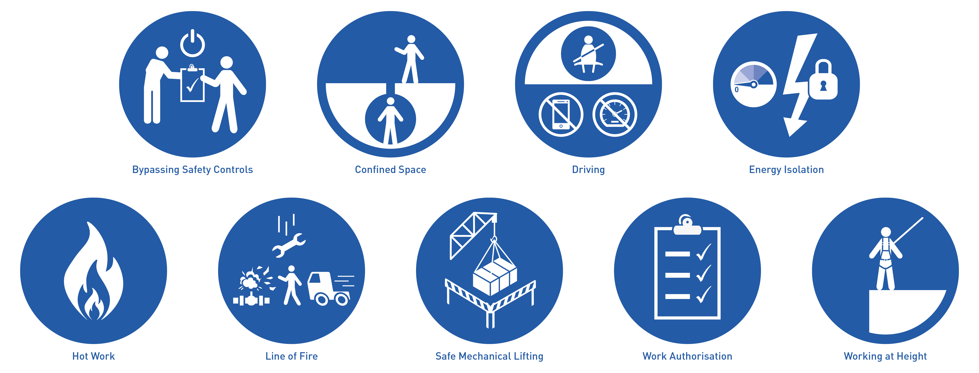

Slide 6
Why adopt the IOGP Life-Saving Rules?
The IOGP Safety Performance database has over 2000 fatal event reports.
Around 80% of the work is performed by contractor employees, working for multiple companies on multiple sites
If we do this together, as an industry, we can have a global impact on safety
By having a common set of Life-Saving Rules, individuals would see the same Rules at every site, making it simpler, clearer, easier to follow and remember. And more efficient for all organisations.

Slide 7
How were the Life-Saving Rules developed?
We wanted to provide workers in the industry with actions they can take to protect themselves and their colleagues, no matter the worksite
Reviewed fatal incidents reported to IOGP to select the activities that are most likely to lead to a fatality
We wanted to have only Rules that were relevant and applicable for the entire industry
Checked our selection against other industry data sources (CONCAWE, ARPEL, NIOSH, OSHA)
We created 9 Rules with a simple icon, and clear actions for individuals
Tested with workforce representatives and Human Performance experts

Slide 8
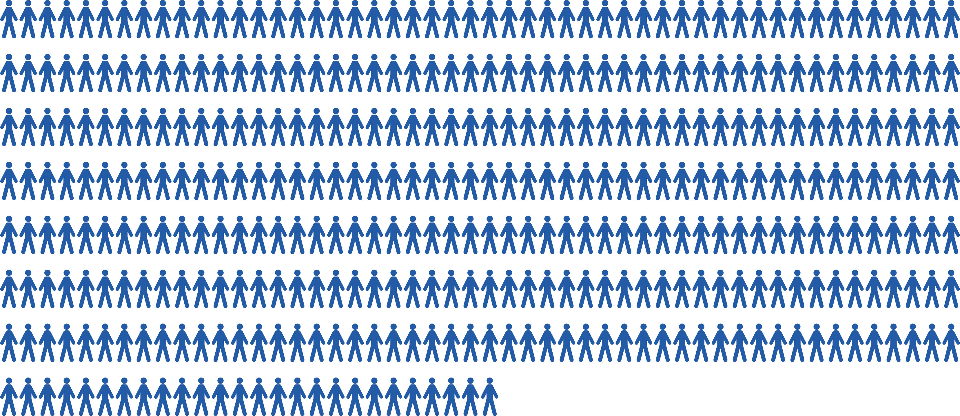
In the last 10 years, 376 people might still be alive if the Life-Saving Rules had been followed*

Slide 9
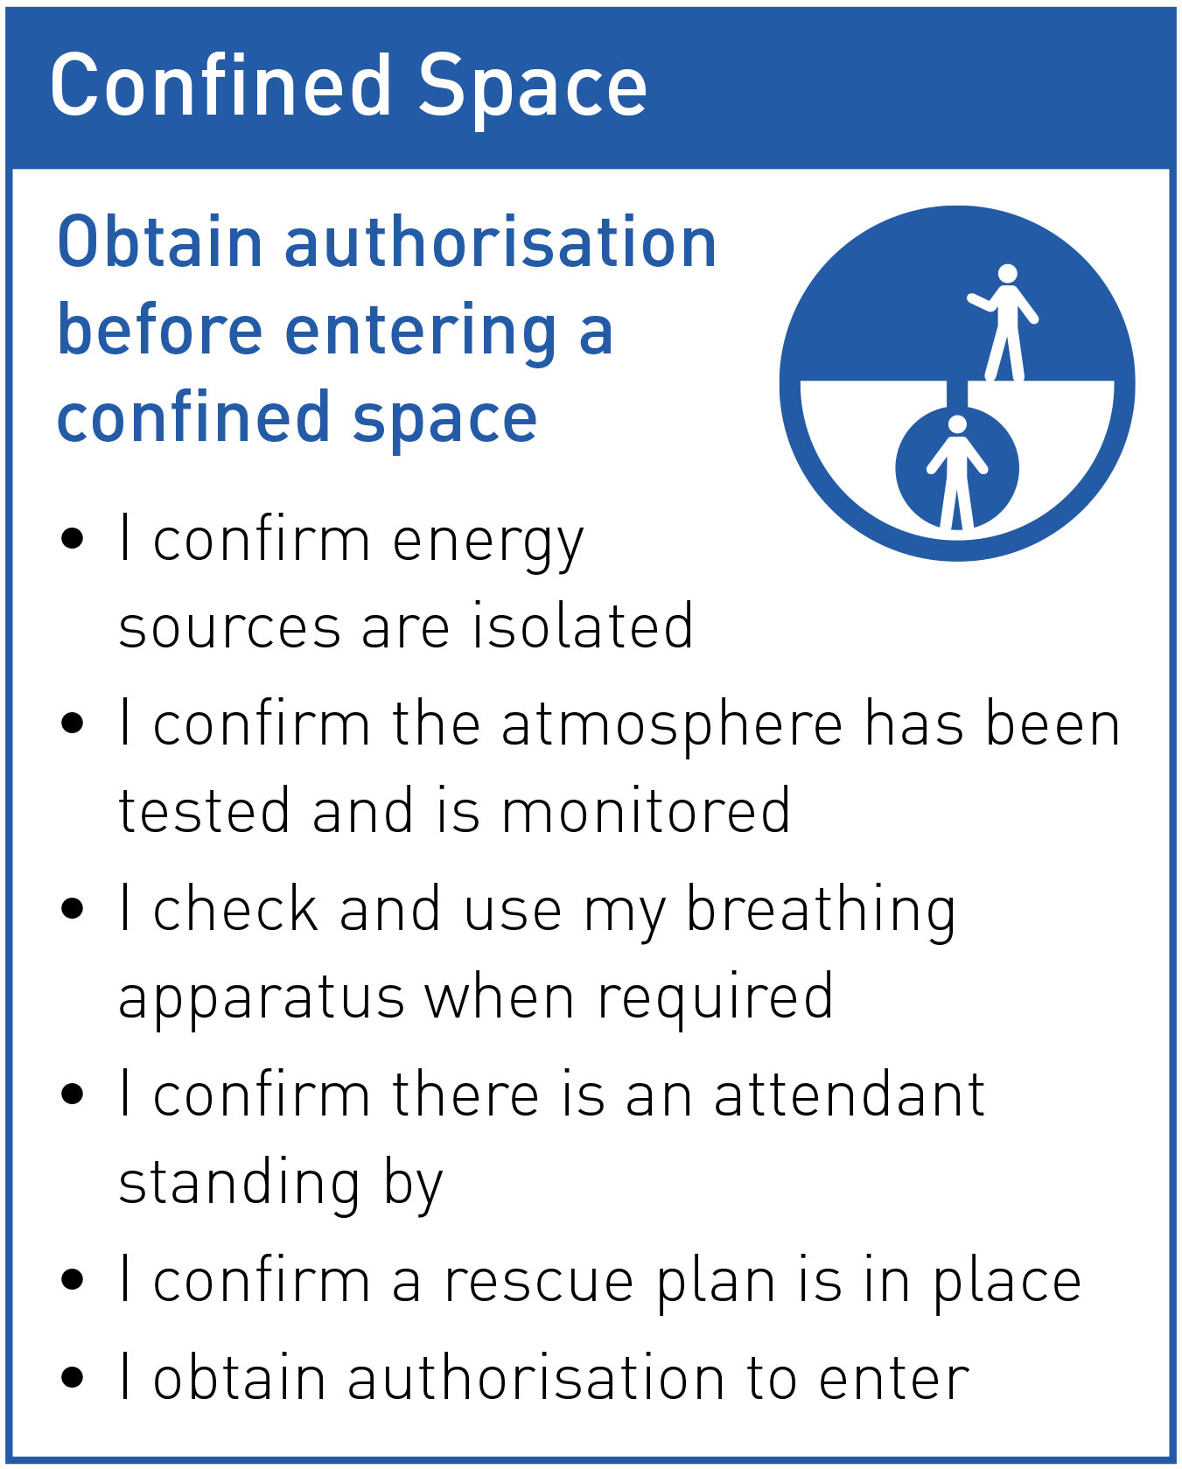
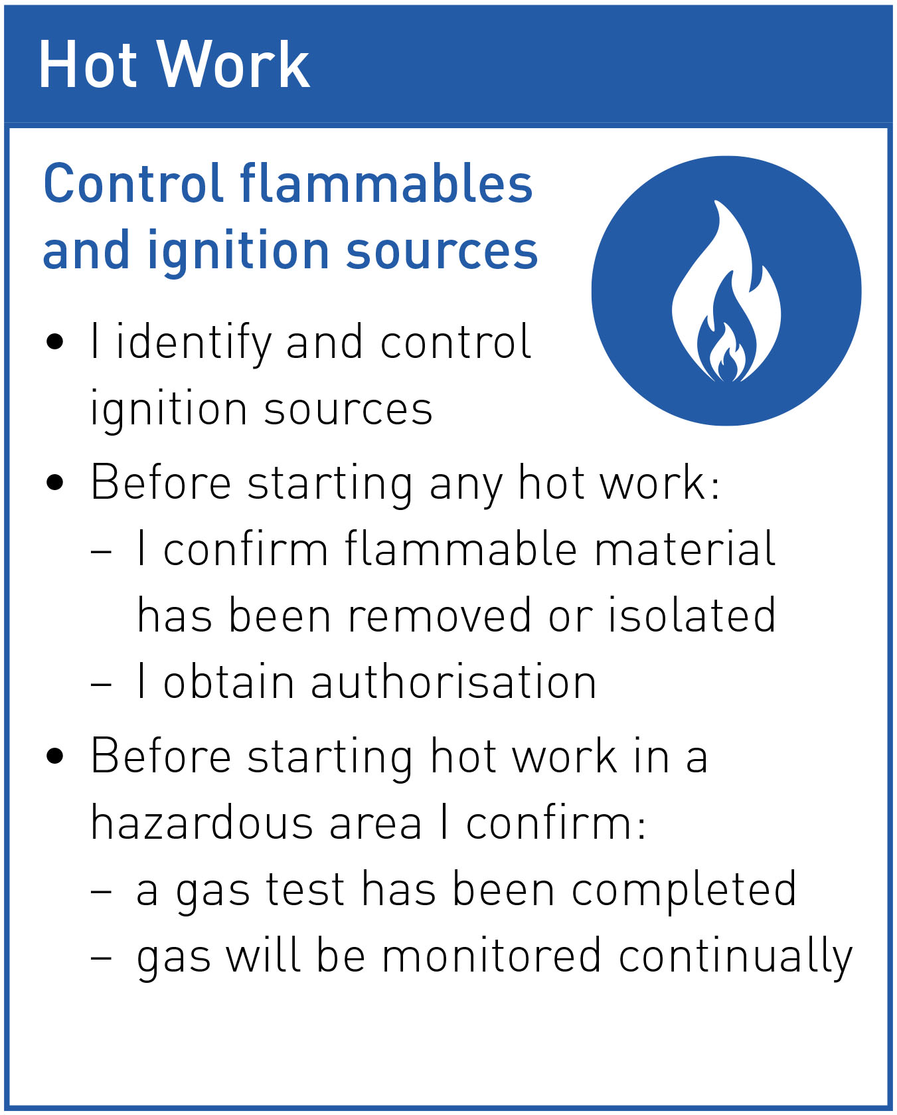
Structure of the Rules
Rule statement
Actions

Slide 10
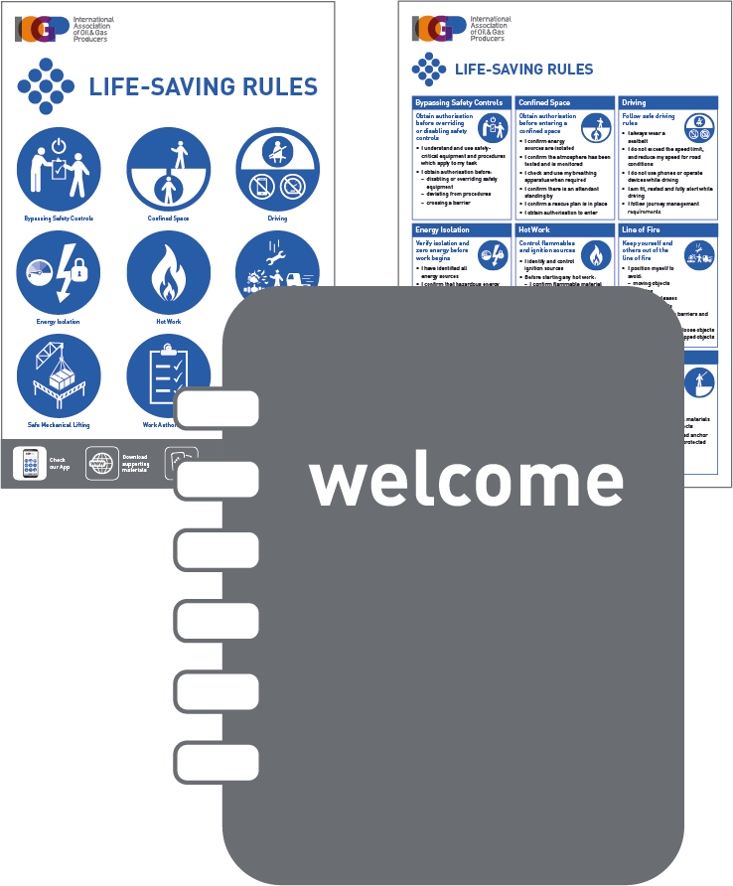
As an implementing organisation we will ensure that:
As a leader, we need your help implementing, ensuring and verifying all of these
STOP
We all have the knowledge
All our employees and (sub)contractor know the Life-Saving Rules, and understand their value
Everything is in place…
Physical workplace conditions, PPE, procedures and safe systems of work exist on all sites so that the Life-Saving Rules can be followed
… and in order
Our personnel are trained and competent. Our
Equipment is fit for purpose, maintained, and in working condition
Jobs are planned
Work is not conducted without a pre-job risk assessment and a safety discussion, such as a toolbox talk; and without emergency plans being in place
We don’t start
Until all involved in a task can confirm they can follow the Life-Saving Rules
We stop
Everyone is authorised to intervene or stop work without adverse consequences if they are in any doubt about the safety of an activity
We improve
If a Life-Saving Rule is not followed, we want to know, and know the reason
so that we can apply lessons learned and create an ever safer workplace.

Slide 11
As a leader we need your help
Know the Rules
and the roll-out plan.
Pass them on
Ensure and verify that everyone within your remit, including contractors and subcontractors, have been briefed
Set the conditions
Ensure and verify that physical conditions, (inc equipment & PPE), procedures and safe systems of work are in place and in working order
Be a champion
Do you see anyone performing work where a Life-Saving Rule is relevant?
Are they following the Rule?
Yes? Great, recognise it!
No? Intervene and coach
Learn
Understand what conditions and environment meant that a Rule was not followed, and what drove people to do what they did, so that lessons can be identified, applied and learned

Slide 12
The Rules in practice
How are you setting the conditions for success?
STOP
Toolbox talks & Safety meetings
Can we learn from incidents that involved a Life-Saving Rule not being followed?
Pre-job planning
Are we doing any work today involving a Life-Saving Rule?
How can we follow the Rule from start to finish?
What needs to be in place?
Is everything in place, and in good working condition?
Last minute risk assessment
Have I done all the Life-Saving Rules actions?
Is everything as we discussed in the pre-job planning?
Are there any Line of Fire hazards or ignition sources we didn’t identify?
Post-job reviews
Did we take all the actions associated with the Life-Saving Rules?
What went well? What didn’t go well?
Anything to note for the next time we have to this perform task or work in this area?
Observations & walkabouts
Do you see anyone performing work when a Life-Saving Rule is relevant?
Are they following the Rule?
Yes? Great, recognise it!
No? Intervene!
Intervention
Intervene or stop the work if a Life-Saving Rule is not being followed

Slide 13
Roll-out plan
[organisation specific – PLEASE EDIT OR REMOVE]

Slide 14
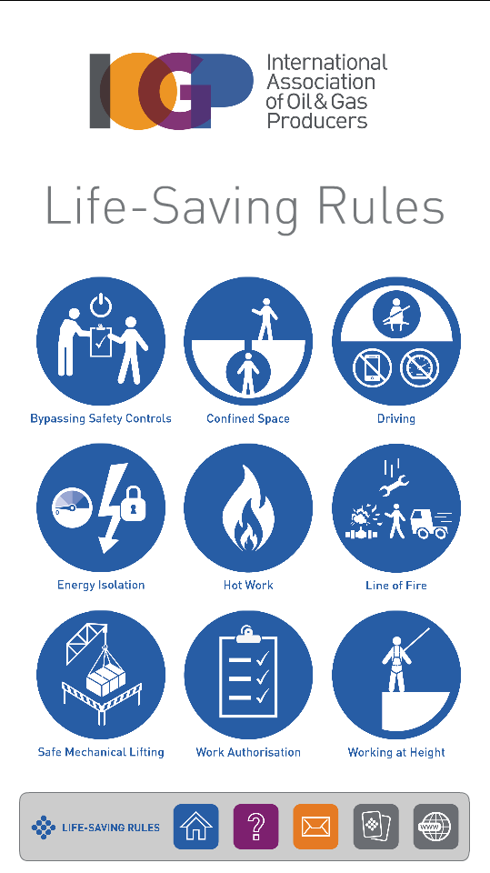
Also available
Website
App
Quiz
Videos
Posters
Presentations
Workcards
Get in touch!
infoLSR@iogp.org
+44 (0)20 3763 9700

